Slide 1
Team Project: Name Data
Team Donkey

Slide 2
Team Donkey

Slide 3
Playbill/Table of Contents
The Team
The File Fixer
The Main Program

Slide 4
The Team

Slide 5
Our Team
Daniel
Alina
Nour
Daylin
Communication Officer
Process Coordinator
Archivist
Architect

Slide 6
Post Mortem
We had a slow start for lab 1 and lab 2
Lab 3 plan had everyone’s responsibilities unclear
Overlapping responsibilities between members
Setting too loose deadlines for tasks
Non-integrated components (names3to4 and multiyear)

Slide 7
Incomplete: Being Honest
Code did not remove ties from csv files
A combined search function
Separating multiple year files and single year files
Have file names include a general area
Ethnicity function does not work for all given files

Slide 8
The File Fixer

Slide 9
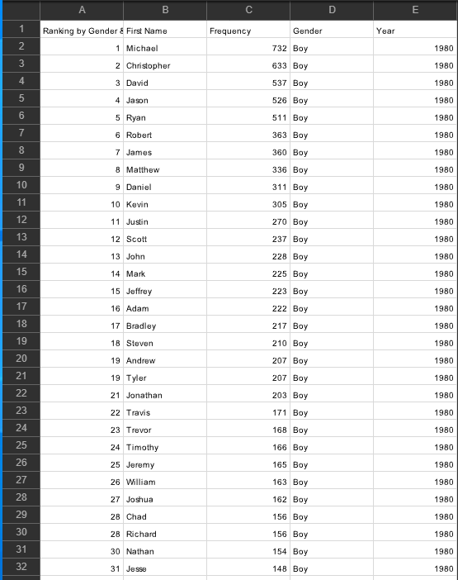
The Required File Format
Rank

Slide 10
Correct File Format
"Gender" , "Genders" , "Sexes" —> "Sex"
"First Name", "Names" —> "Name"
"Frequency", "Count", "Frequencies", "Value", "Counts", "Total", "Totals", "Number", "Numbers" —> "Count"
"Position", "Positions", "Ranks" —> "Rank"
"Years" —> "Year"

Slide 11
Running the Formatter
python3 names3to4.py file.csv -f place -y year -s sex
python3 names3to4.py Scotland2019F.csv -f Scotland-y 2019 -s F

Slide 12
The Naming Scheme
PlaceYearSex.csv
Alberta2020M.csv

Slide 13
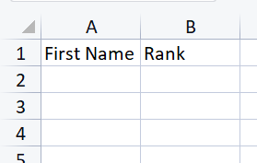
Testing Example:NovaScotia2003F.csv

Slide 14
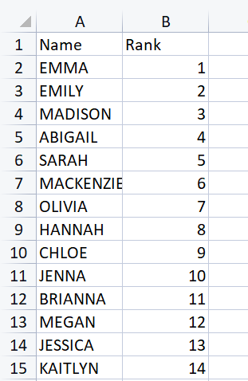
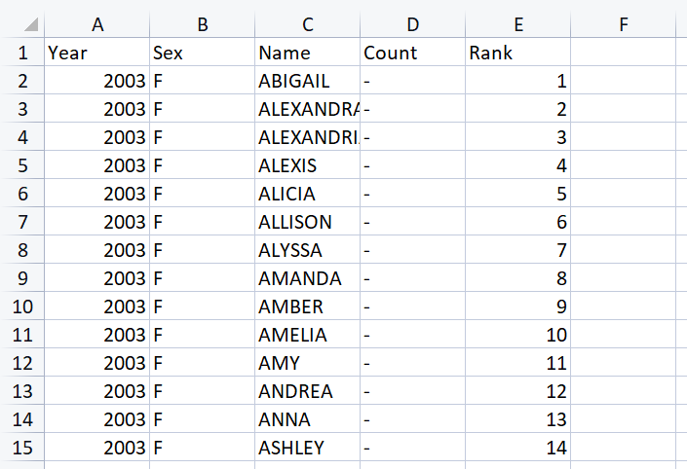
Testing Example: NewFoundLand2003F.csv

Slide 15
The Main Program

Slide 16
Menu: Run by pressing the go button
Track ethnicity
Search for keywords in the files
Search for the top 10 in any given year in any location
Print graphs based off name data
Print out the names alphabetically
Print out the data
Exit

Slide 17
Breaking our code
Non-California for ethnicity will break the code
The following has been error trapped:
Enter a choice: wrong number and non-number
Enter a year: wrong years and non-years were tested
Enter a file: wrong files and empty files were tested
Non-California or Non-Australia for search keywords

Slide 18
Questions
Find out the … for a certain place
Most popular names of a year?
Decline of a name over time?
What are all of the names?
Where does a name rank?

